Slide 1
International Conference for
Academic Disciplines
in Rome, Italy
October 29 to 1 November 2012.
PhD Olivera Novitovic
ASSESSMENT AND FEEDBACK: CASE STUDY IN HIGH
TECHNICAL SCHOOL IN SERBIA

Slide 2
Olivera Novitovic
Professor of materials and environmental protection, High Business Technical School of Professional Studies Uzice and Belgrade Business School Uzice and Belgrade in Serbia.
I finished Technological-metallurgy faculty, master's and doctorate at the same university. I published about 70 scientific papers, 9 books, 2 patents, and now participated in two international projects. I am a member of the Institute of Materials in London since 1993, a member of the committee accreditation body Serbia, Vice President Board of Directors of the Regional Sanitary Landfill Deep, participants in I participated in the development of local economic and environmental development of local-Uzice and Belgrade.

Slide 3
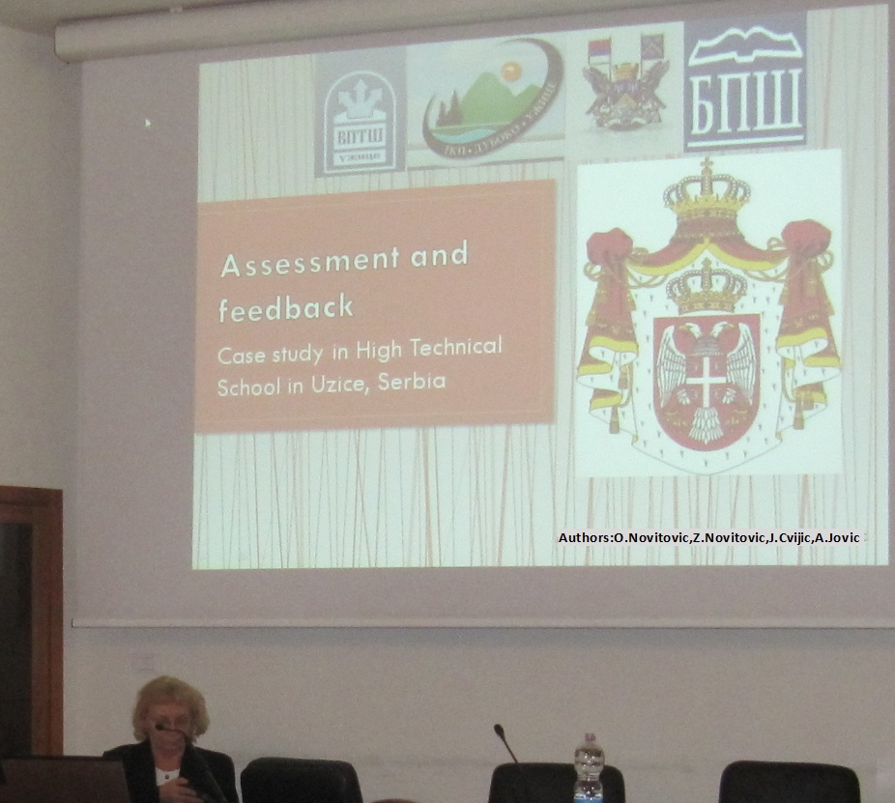
Lecture

Slide 4
Assessment need not take time away from learning; assessments can be learning experiences in themselves. Active assessment strategies enhance student content understanding and promote skills that will be beneficial to students throughout their lives. The ability to see the big picture, develop effective oral and written reports and the ability to work cooperatively with their peers are skills that are promoted by active assessment. Action research is a process of systematic inquiry that helps teachers to assess learning from the perspective of what they do in the classroom. Teachers examine a situation or problem very carefully to find out "why" or "how" things happened the way they did. They analyze their own beliefs, values, and assumptions about teaching and learning, knowledge and curriculum, and how these impact the way they interact with students.

Slide 5
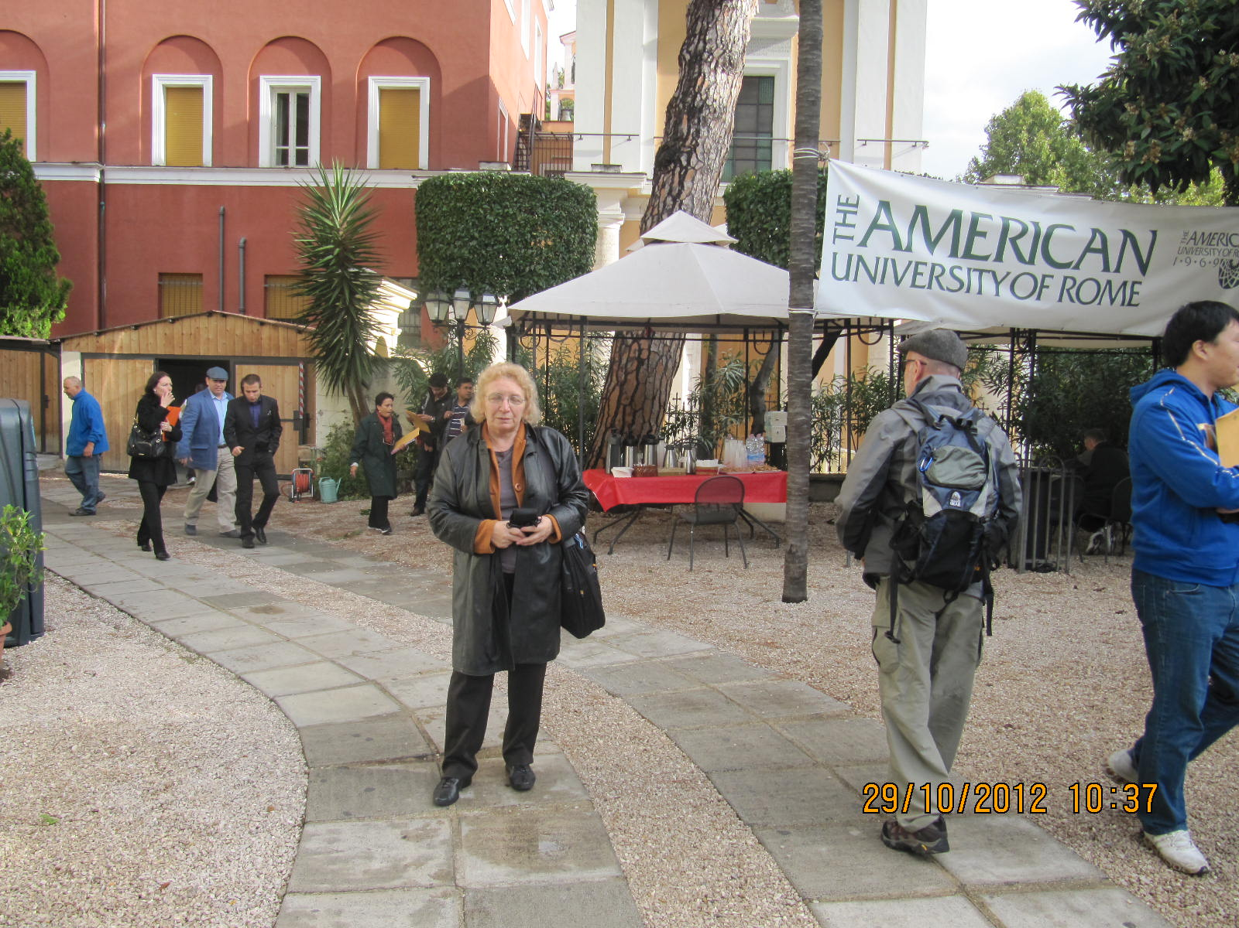
Feedback can be used as part of the assessment activities. Through feedback we can assess learning and teaching experience of students provided by teachers.
Respite before the conference

Slide 6
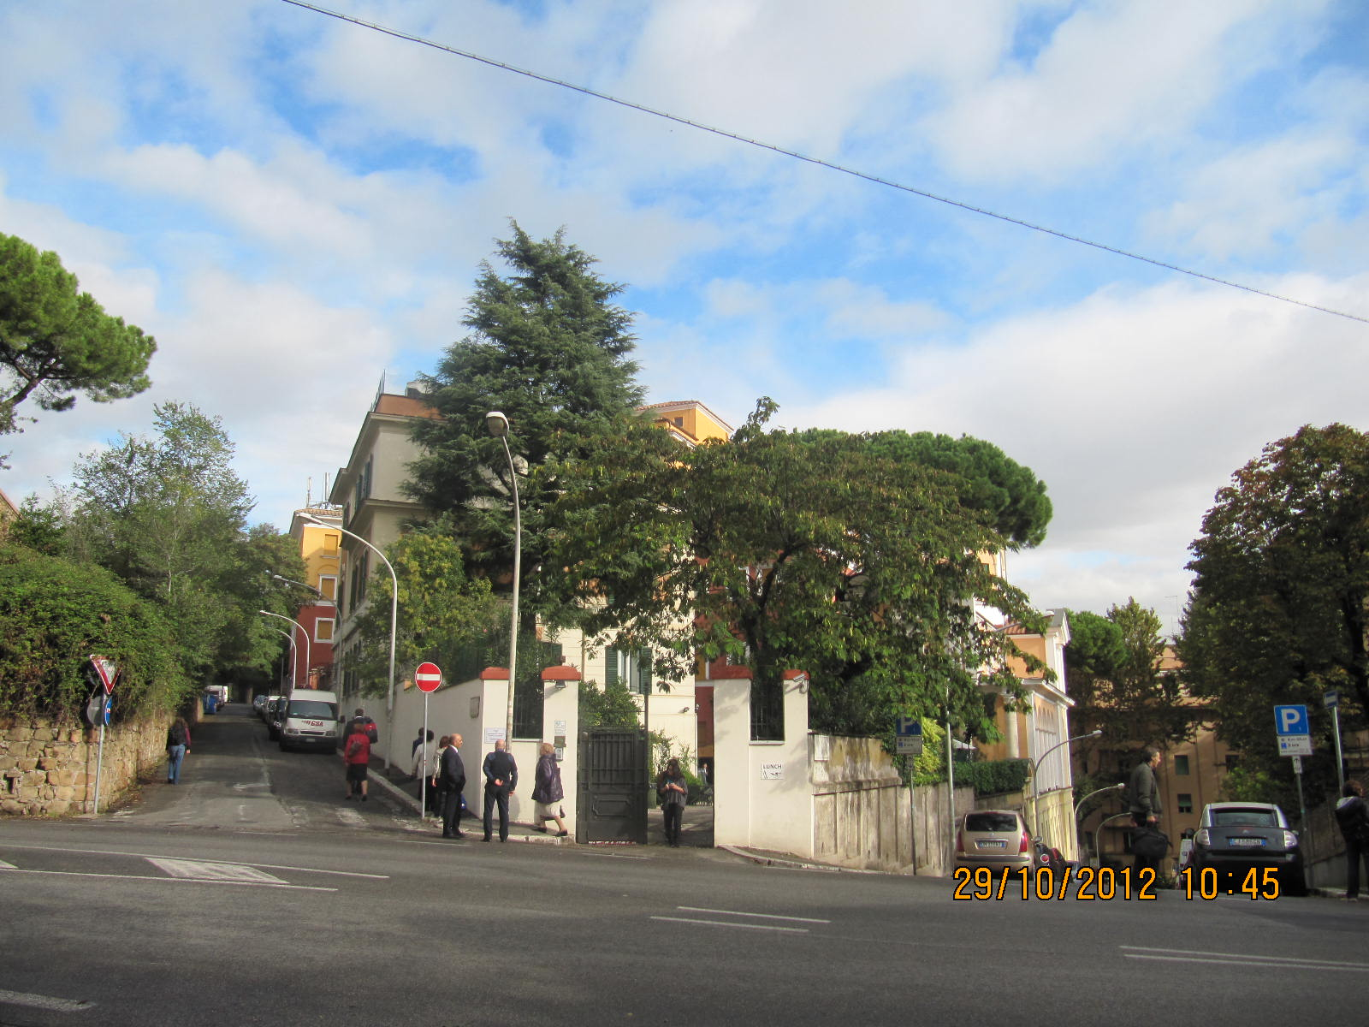
An aerial view of the American University of Rome campus.

Slide 7
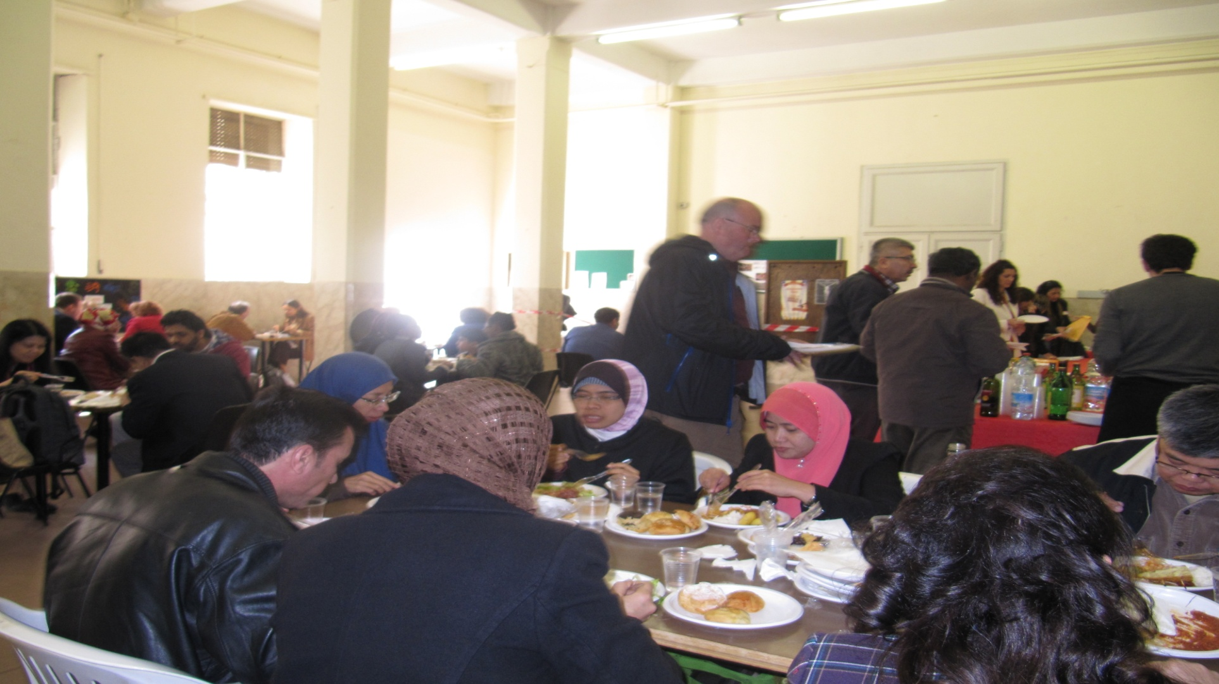
Lunch time

Slide 8
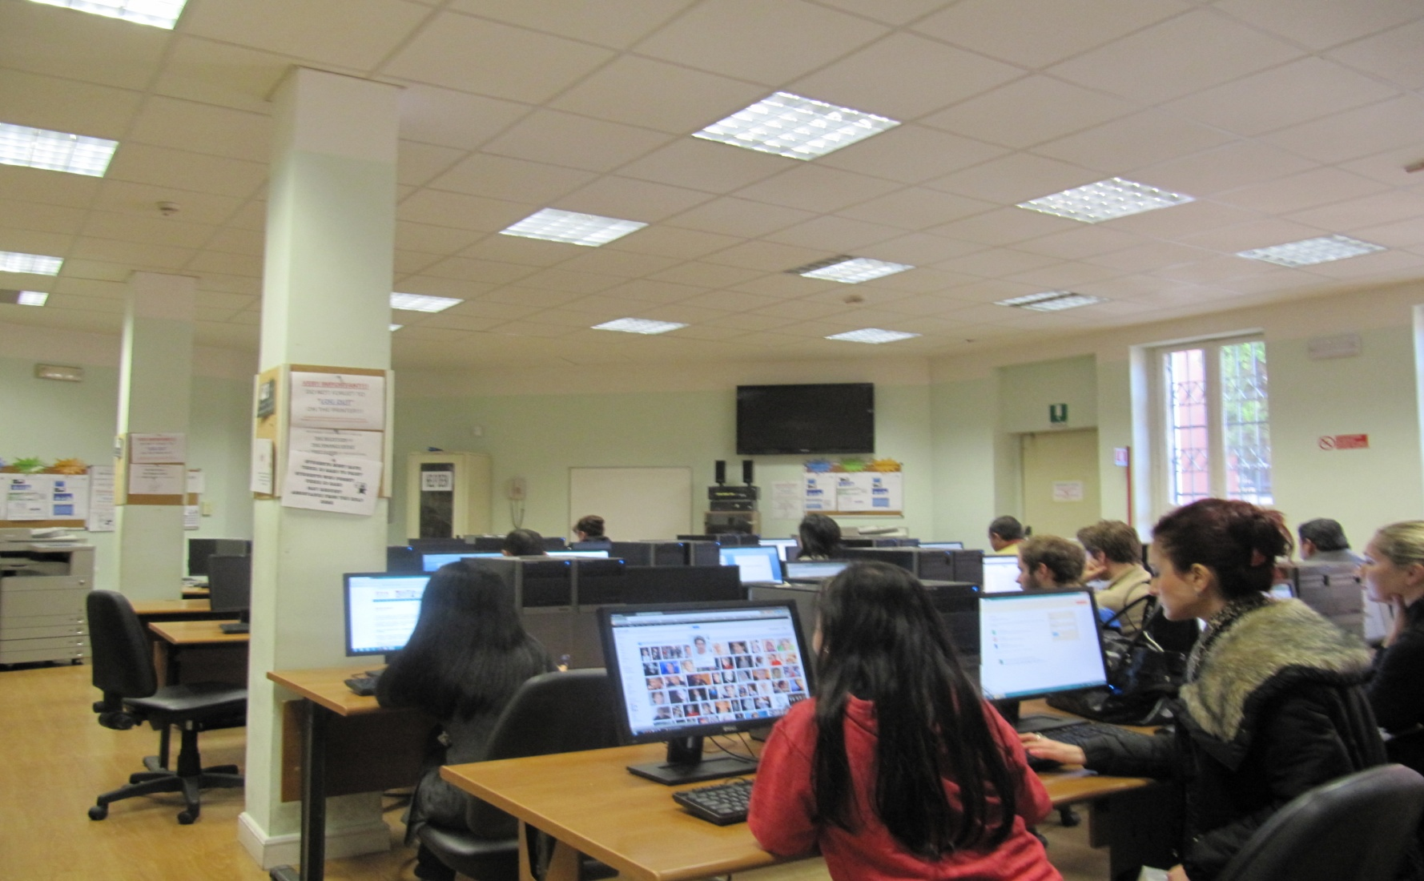
Workshop

Slide 9
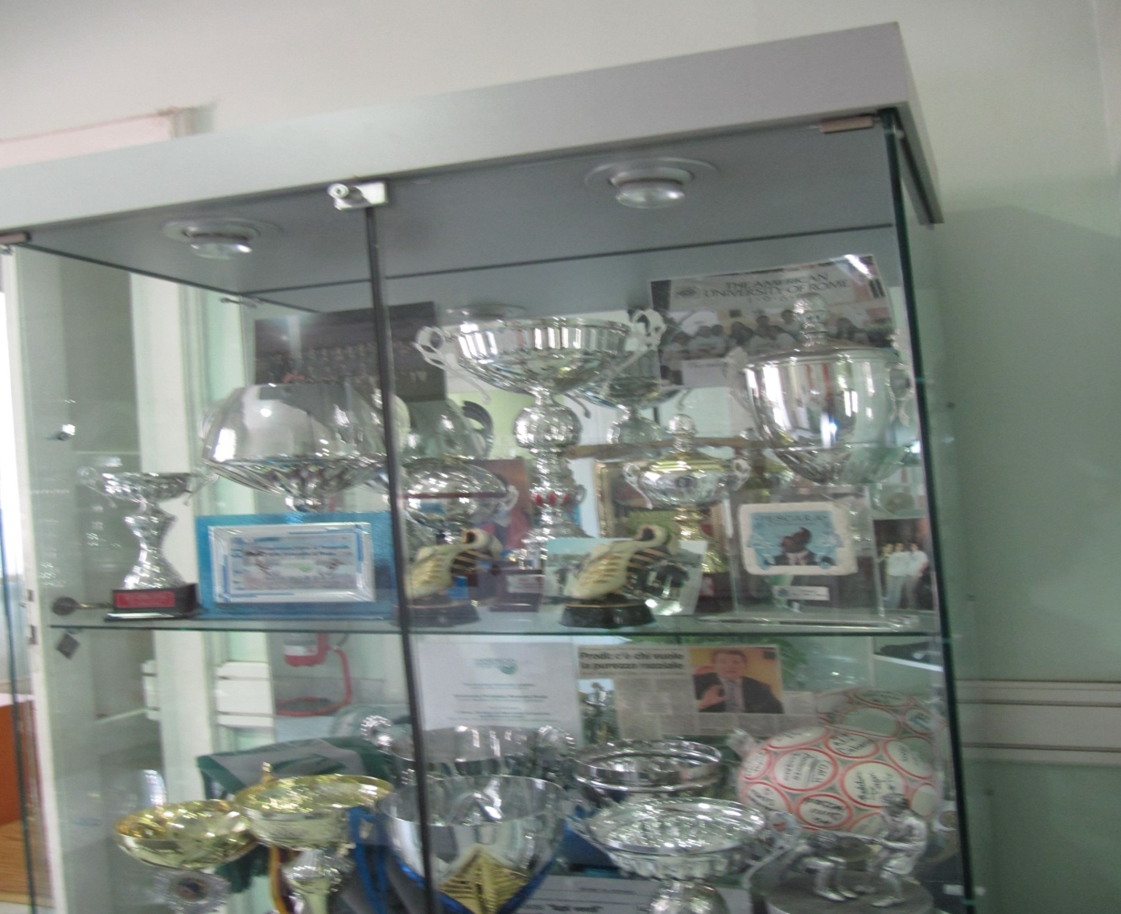
Successes

Slide 10
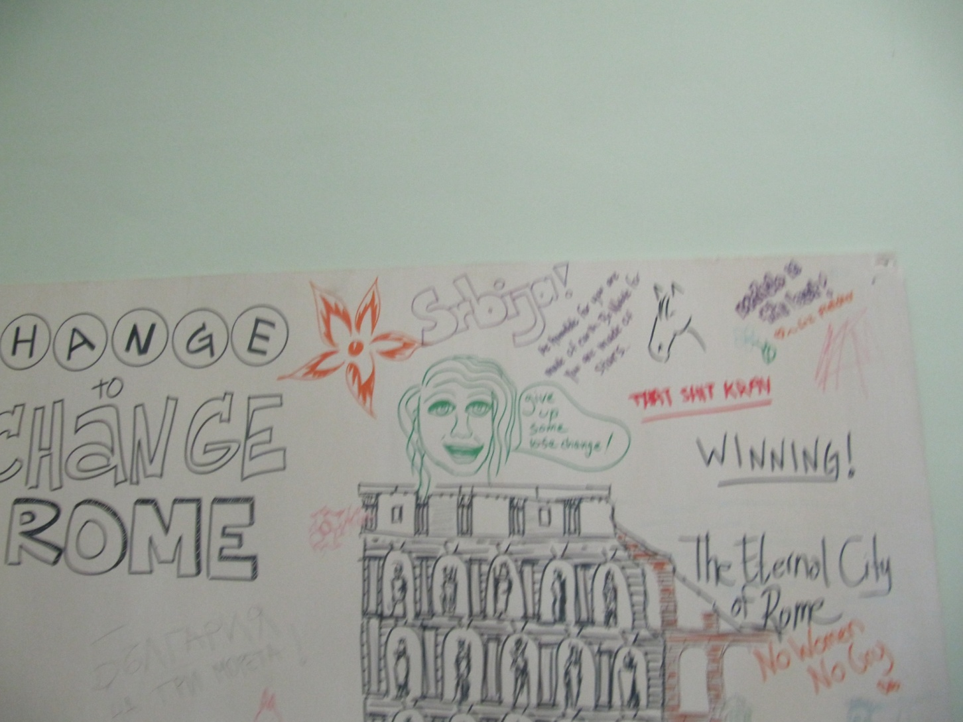
We present

Slide 12
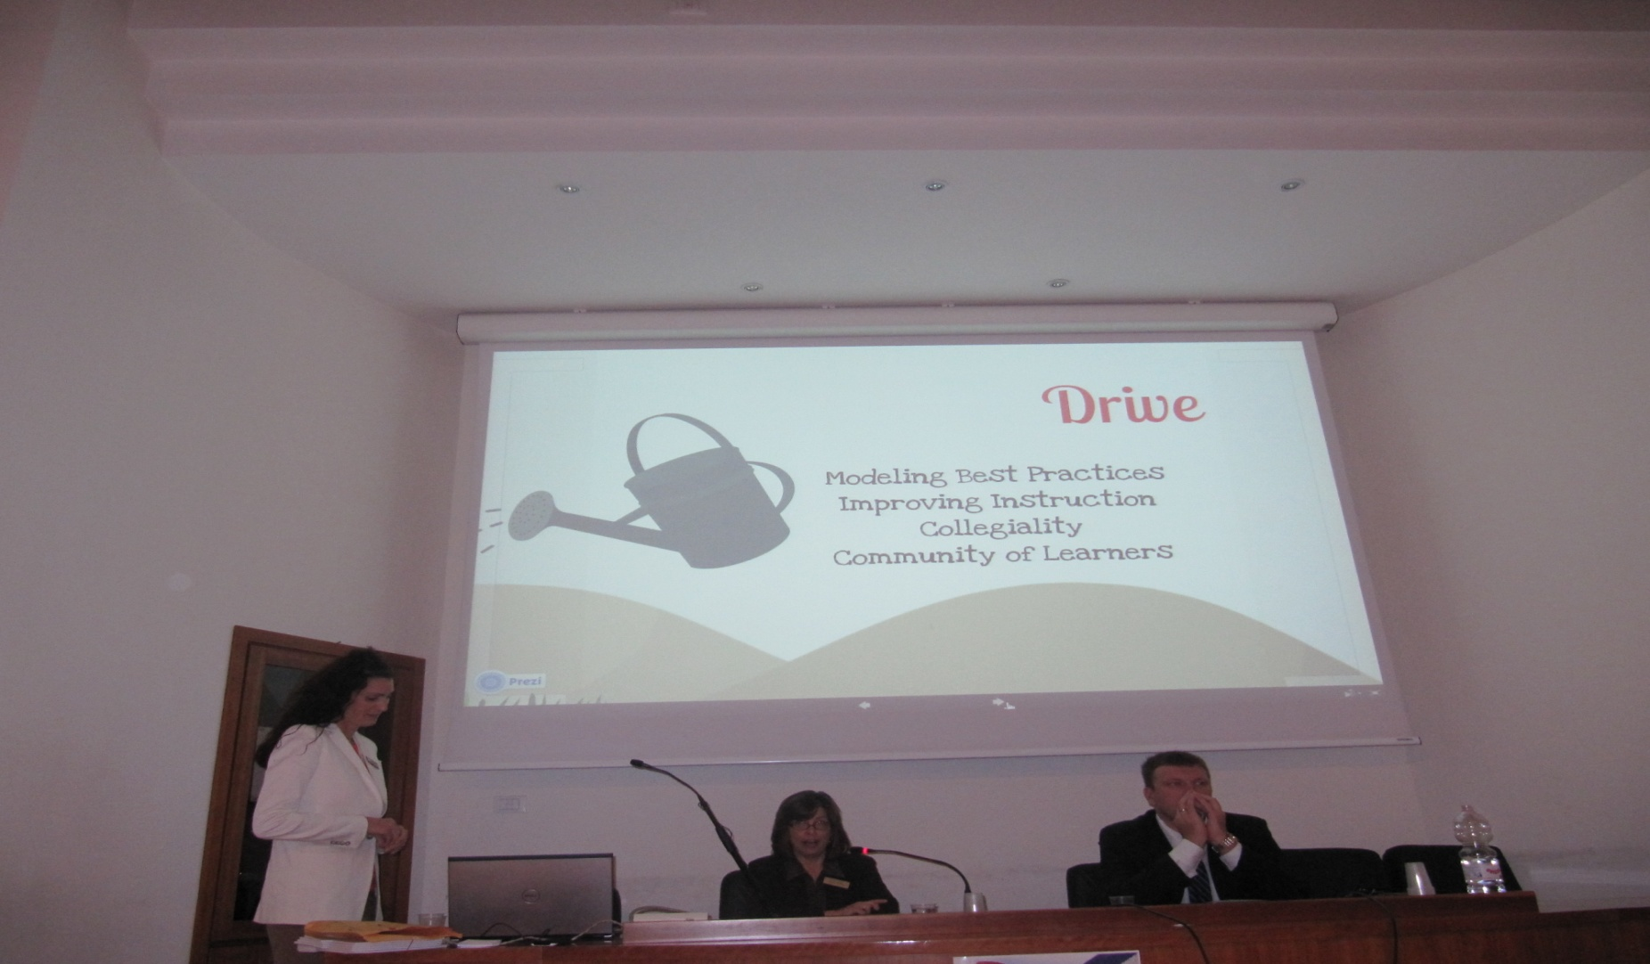

Slide 13
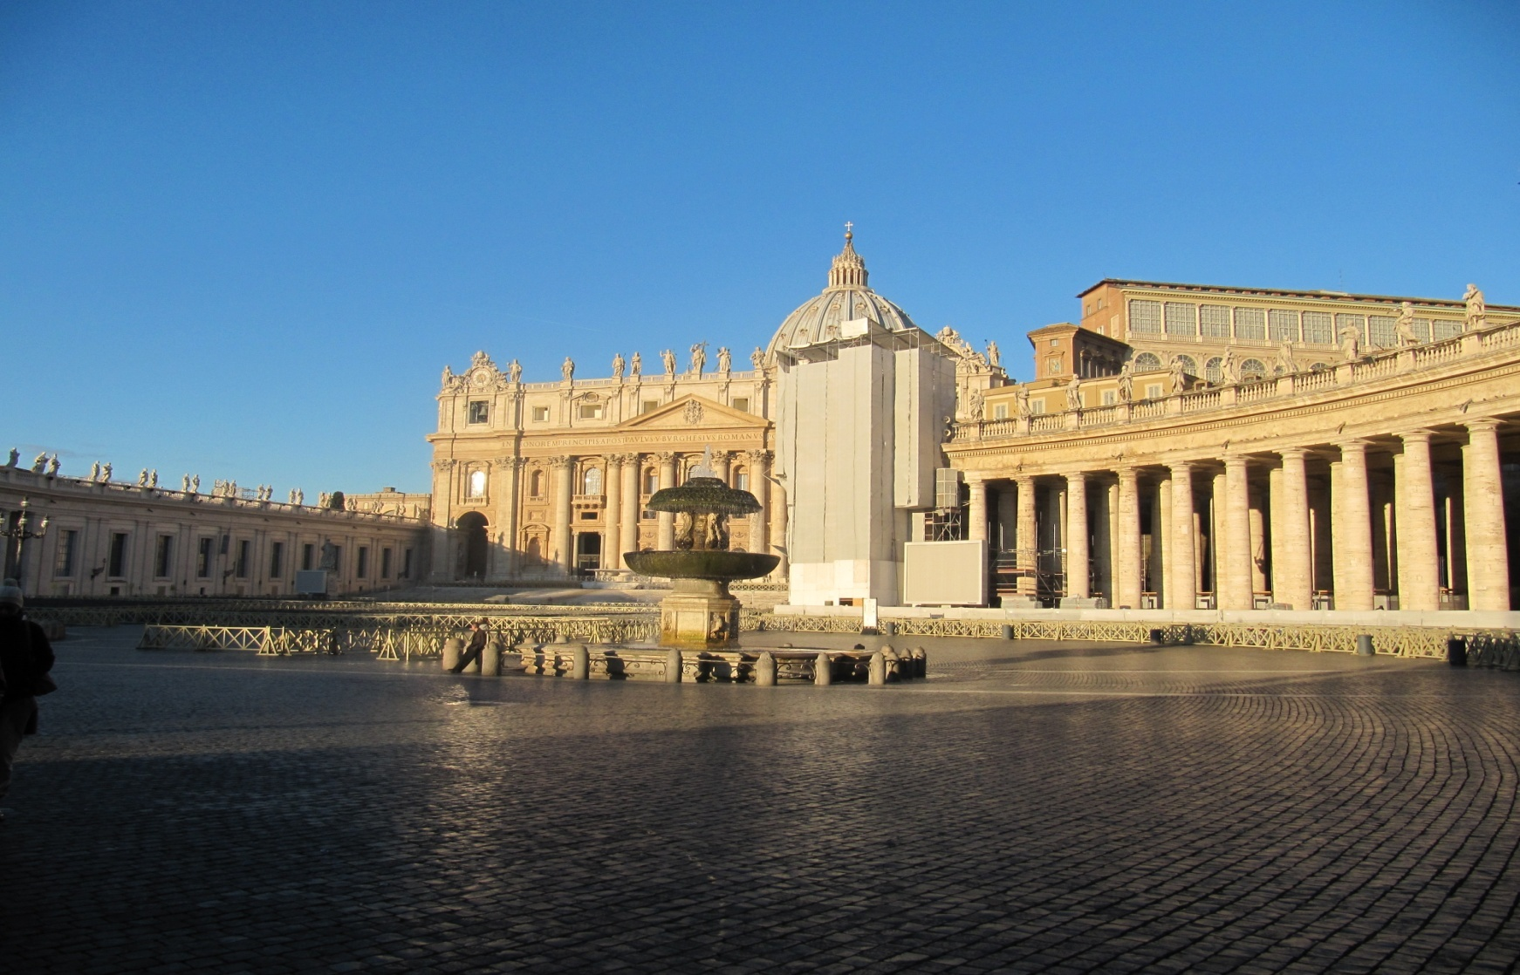

Slide 15
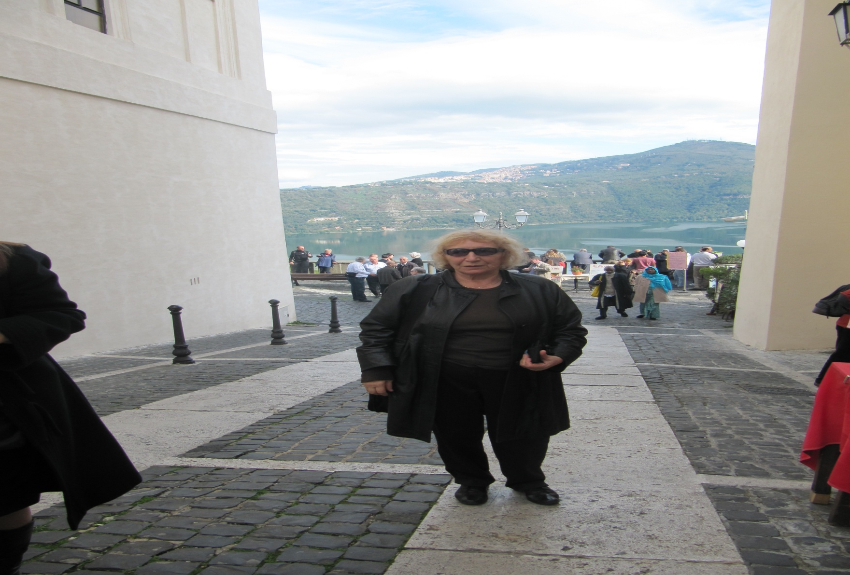

Slide 16
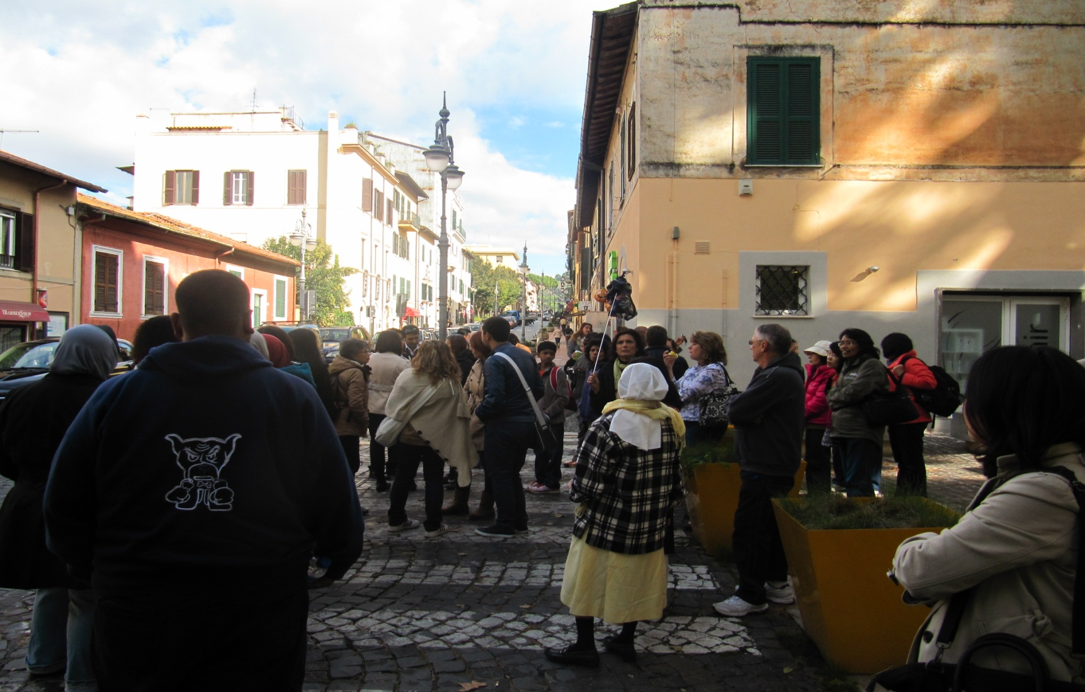

Slide 17
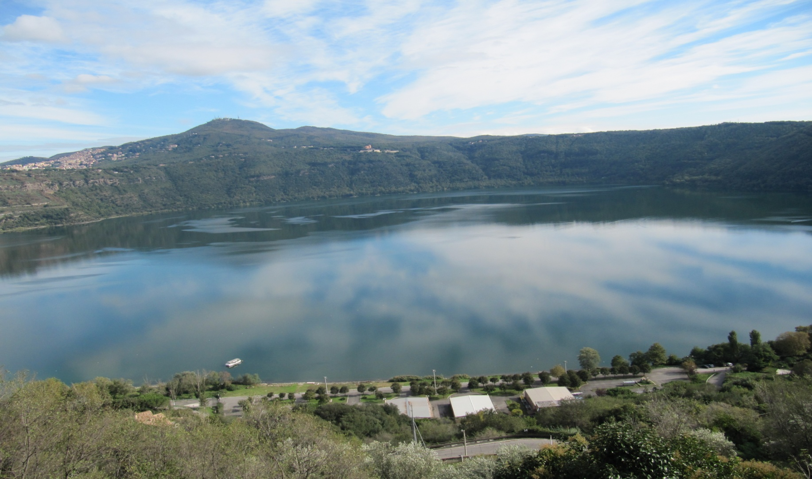
Excursion

Slide 18
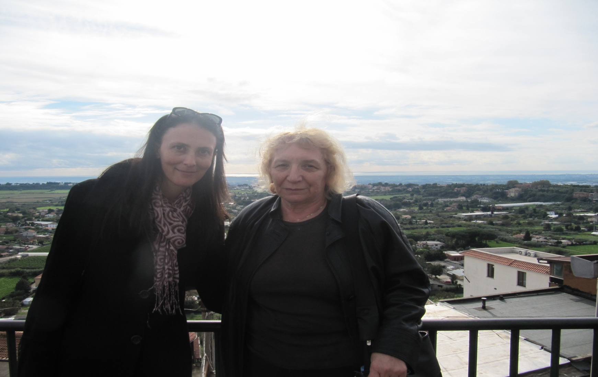
Spending time with my colleague from Malta

Slide 19
References
Modernisation of Post-Graduate Studies in Chemistry and Chemistry Related Programmes, TEMPUS 511044-TEMPUS-1-2010-UK-TEMPUS-JPCR, MCHEM: http://www.sheffield.ac.uk/polopoly_fs/1.18989!/file/The-inclusive-learning-and-teaching-handbook.pdf
www.sheffield.ac.uk/content/1/c6/08/79/71/Principlesof-Feedback.pdf
www.good.group.shef.ac.uk/wiki/index.php/Assessment_and_Feedback
www.sheffield.ac.uk/lets/techno/services/egrs.html
www.sheffield.ac.uk/lets/inclusive ISBN: 978-0-9567228-0-5
Formative assessment and self‐regulated learning: a model and seven principles of good feedback practice, David J. Nicol , Debra Macfarlane‐Dick (University of Strathclyde, UK, University of Glasgow, UK), 2007
http://alexrister1.wordpress.com/tag/eric-mazur/
http://cft.vanderbilt.edu/library/articles-and-essays/the-teaching-forum/highlights-from-a-conversation-with-eric-mazur/

